Slide 1


Teaching in the 21st Century:
CYBER-BULLYING
Dr. Robin Bright
Education Undergraduate Society, Faculty of Education ANTI-BULLYING CAMPAIGN
Monday, October 6, 2014
University of Lethbridge
Lethbridge, Alberta

Slide 2
Cyberbullying
http://www.youtube.com/watch?v=bfT2qqrqzgo

Slide 3

It’s not about the technology…
A key point to understanding technology and children is to keep in mind that the core issue is not about the technology. For children and teens, technology and life online is all about connection, relationships and friends. The technology is simply a vehicle.
ChildrenOnline.org

Slide 4
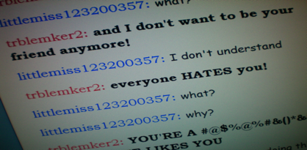
Cyberbullying
What is it?
Willful harm inflicted through electronic media
Use of electronic devices to threaten, harass, embarrass, socially, exclude, or damage reputations and friendships

Slide 5
Key Research Findings
Bullying perpetration rates range from 4-18 %
Victimization rates are considerably higher at 7-35%
Cyberbullying tends to be low in grade 5, peak in grade 8, and decline by grade 11
Over 50% of youth who are cyberbullied don’t inform any adulst about the incidents
Less than 35% of students would inform adults if/when they knoew about someone else being cyberbullied

Slide 6

How vulnerable are you to cyberbullying and cybercrime?

Slide 7
Digital Footprints
Personal information of yourself, friends and family
Sharing passwords
Connections with people you don’t know
Plans and vacancies
Quizzes, prizes, samples and products
Peer-to-peer software
Online gaming disclosure
Images and video

Slide 8

Cyber Talk (2006-2008)
676 cyberbullying comments
“Describe a situation you know about in which someone was the bully or bullied online and what happened as a result.”
(http://cybertalk.ca/)

Slide 9
Forms of Cyberbullying
Harassment
Denigration
Impersonation and Pretending
Outing or Trickery
Exclusion
Threats and Violence
Cyberstalking
Frenemies

Slide 10
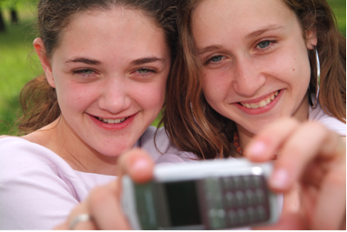
Cyberbullying
37% know someone who has been bullied online
19% have been bullied themselves online (target)
17% have bullied others online

Slide 11
Online Social Norms (cyberbully.org)
Life online is just a game.
Look at me. I am significant.
It’s not me- it’s my online persona.
What happens online stays online and has no real world consequences.
If the internet lets me do it, it must be okay.
Only the people I intend to see what I post will look at it.
I have the right to free speech; to write or post anything I want regardless of the harm it may cause another person.
Notes:
Nancy Williard from the center for safe and responsible internet use believes that there is a slightly different set of social norms that contribute to cyber bullying. I also believe that our social norms face to face have changed as well to view cruel as cool. Let’s spend a bit of time discussing cell phones as this is an area of struggle in schools.

Slide 12
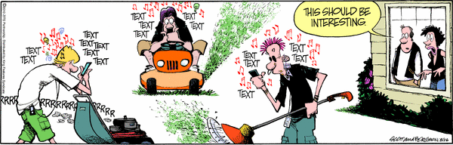

Slide 13
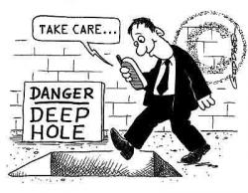
Cell phones
Parents provide them for safety
Youth use them for texting (avg. 81 daily)
Under 14 , consider no text, no camera.
Adults model appropriate usage.
School policies must educate.

Slide 14


Who are the cyberbullies?

Slide 15
The Importance of Teacher Response to Cyberbullying
Mishna et. al (2005) found that…
“Teacher training is critical in identifying and responding to (cyber)bullying. Teachers require, and want, further training to increase their confidence and competence in this area.”

Slide 16
Teacher education
                Teachers need:
                To have a clear definition of bullying
To know that their understanding and response can have an effect of students
To recognize inconsistencies between their views and their reactions to cyberbullying
To know a child’s view may differ from their own

Slide 17
The Role of Adults in Positive Intervention
Adults need to talk to youth about cyberbullying-letting them know they will be supportive
Reduction of harm approach: education on net-etiquette and safety (prosocial behavior)
Adults need to make it clear that online and cell phone privileges will not be revoked is cyberbullying is reported
Conduct more work with intervention and prevention programs

Slide 18
Recognizing the Problem
Talk and acknowledge cyberbullying.
Be accessible.
Be alert to anxiety, emotional distress and withdrawal.
Watch for changes in behavior.
Appearing emotionally upset after internet use.
Disturbed relationships with parents, family and friends.
Subtle comments about online concerns.
Notes:
Robin

Slide 19
How?
Jenn Cowie (Wilson Middle School)
The Wilson Way: Technology, Literacy, Leadership
Six-week mandatory exploratory option
An emphasis on developing strong communication skills through technology prepares students to interact effectively
in our changing world.

Slide 20
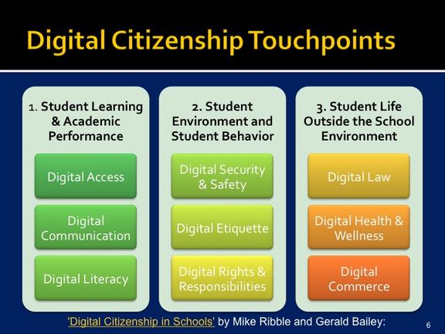
ICT Outcomes and 9 Pillars of Understanding
The ICT curriculum presents concepts within three interrelated categories:
communicating, inquiring, decision making and problem solving
foundational operations knowledge concepts
processes for productivity

Slide 21
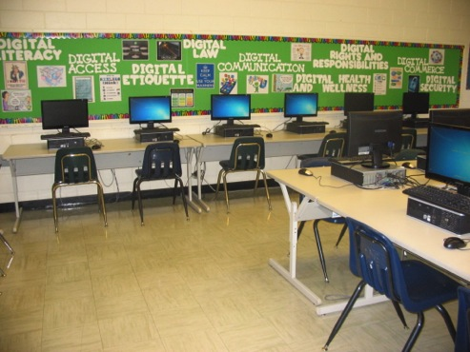
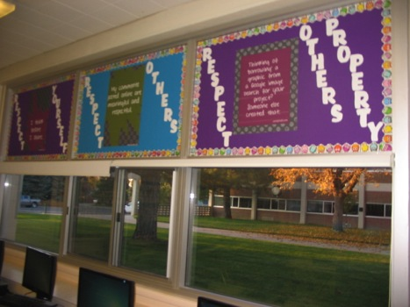
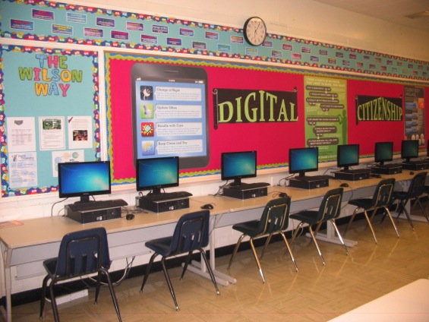
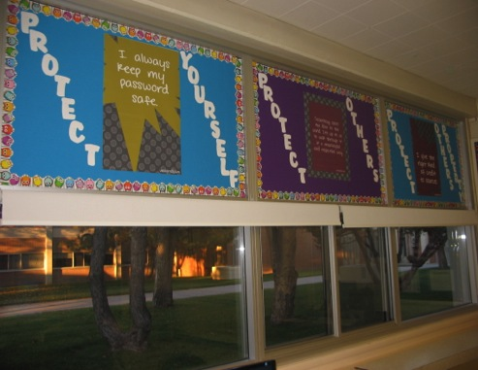

Slide 22

Who can help?
Creating Caring, Respectful, and Safe Learning Environments-Alberta Education and The ATA
http://education.alberta.ca/admin/supportingstudent/safeschools.aspx
School Resource Officers

Slide 23
Techno Brain
State of continuous partial attention
Reduced learning
Reduced time spent with peers
Reduced physical activity
Identity construction.
Notes:
‎

Slide 24

What to do?
STOP, BLOCK, TALK AND SAVE
read privacy policies and settings
restrict access to your sites
take precautions when meeting people you have met online.
The billboard test.
Stop ~Think~ Connect

Slide 25
Best Practices for Schools
Introduce Internet safety education early.
Revisit and spiral skills each year from elementary through high school.
Select topics that are developmentally appropriate and reflect the typical risks and issues facing a particular age group.
Create units for developmental age groups with topics that can integrate with existing curriculum.
Use quality curricular materials AND current events to teach Internet Safety topics.
Provide students with a lot of opportunity to discuss these issues.
Provide opportunities and a forum for parent education and discussion.

Slide 26
Resources
http://education.alberta.ca/admin/supportingstudent/safeschools.aspx
http://mediasmarts.ca/
http://mediasmarts.ca/sites/mediasmarts/files/pdfs/lesson-plan/Lesson_Winning_Cyber_Security_Game.pdf
http://mediasmarts.ca/sites/mediasmarts/files/pdfs/publication-report/summary/YCWWIII_Cyberbullying_ExecutiveSummary_2.pdf
http://www.iste.org/
http://www.prevnet.ca/
http://cehs15.unl.edu/cms/index.php?s=2&p=124

Slide 27

Questions
Notes:
Thank you.

